Slide 1
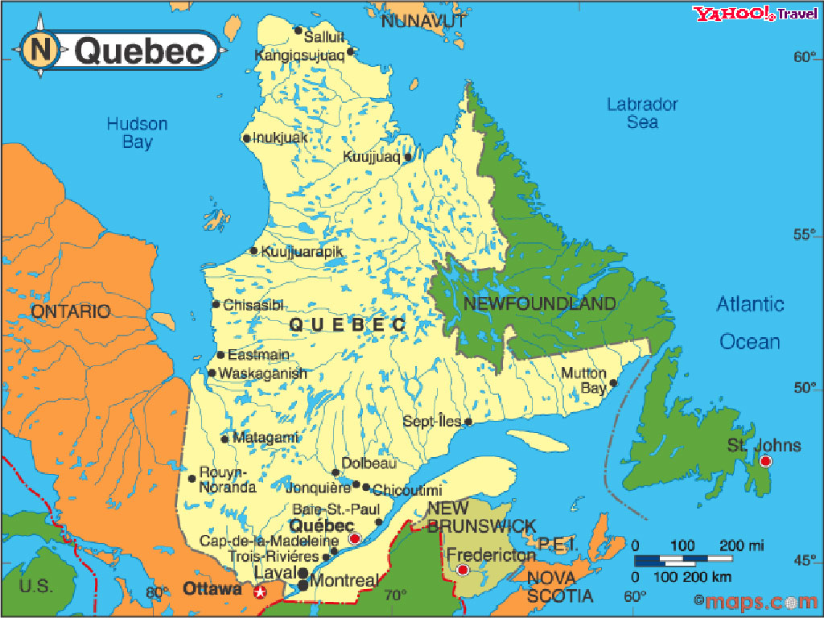

QuÉbec IMMERSION Trip – Parent Meeting
March 23, 2016
Mr. Helwani // Mr. Nadeau
Ms. Kolb // Mrs. Shanley

Slide 2
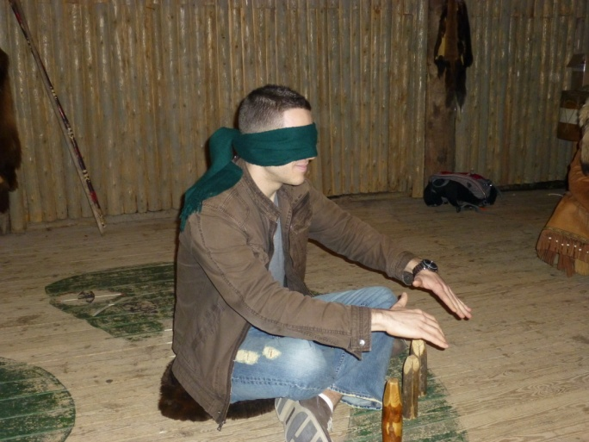
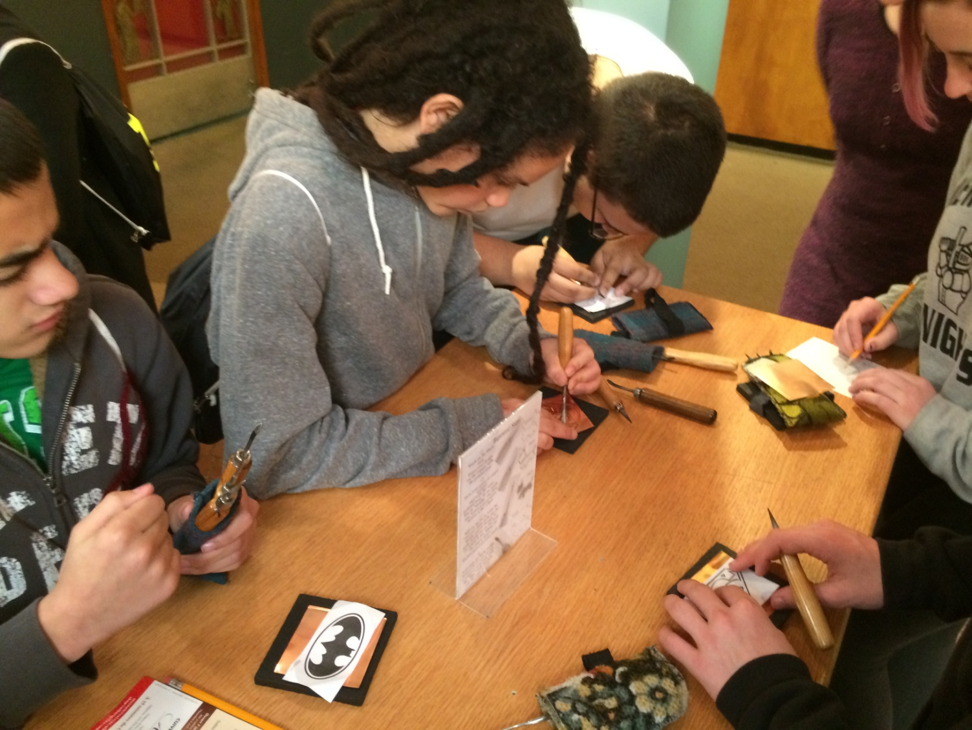
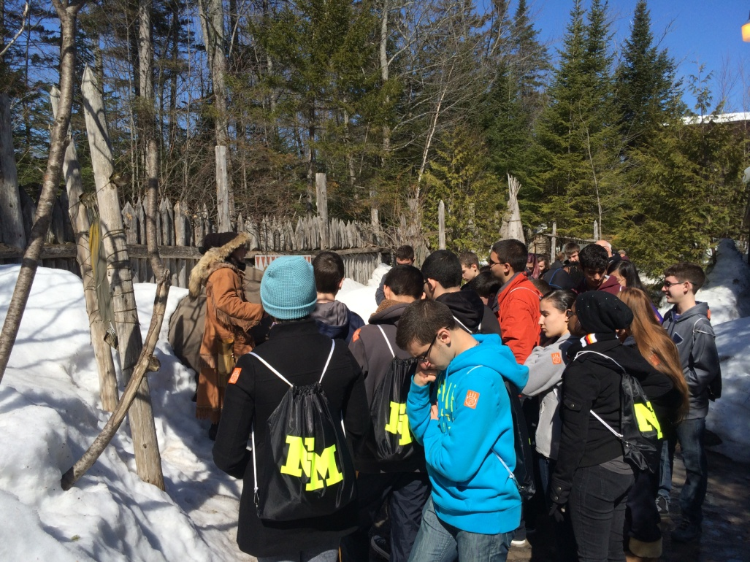
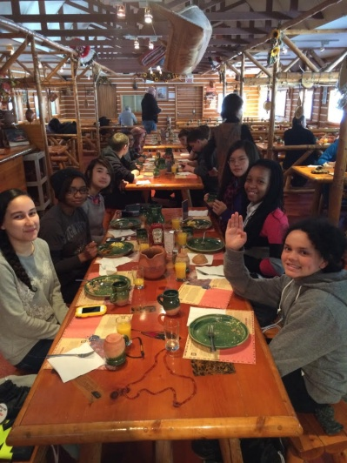
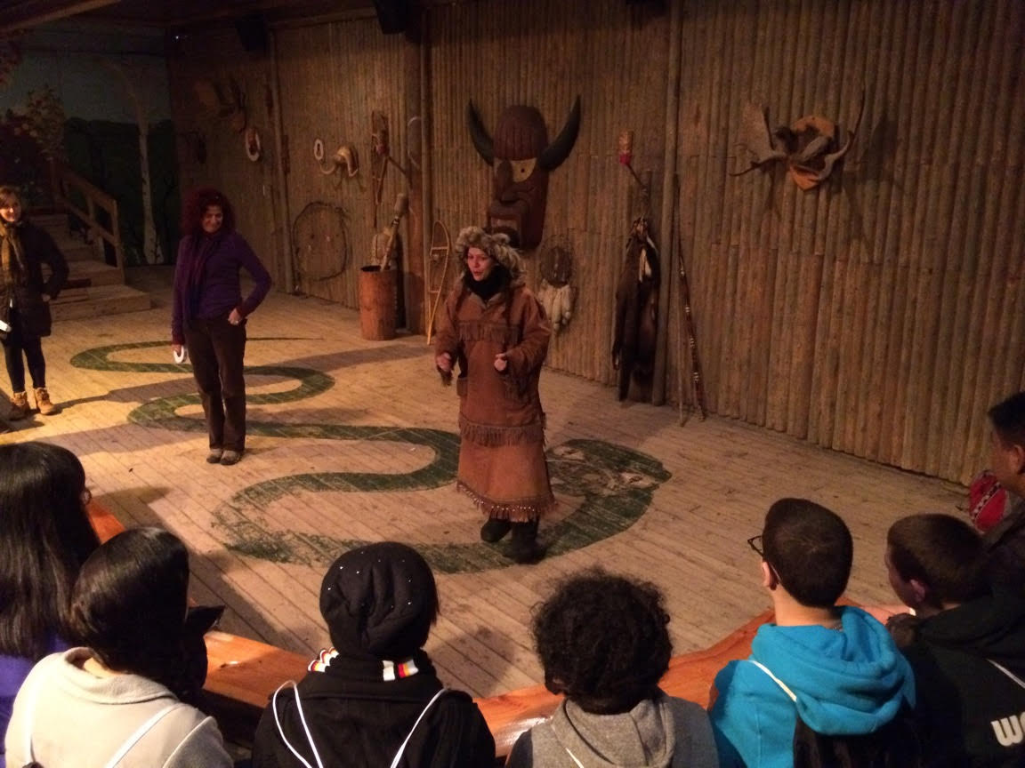
Je me souviens… (QIT – 2014)

Slide 3
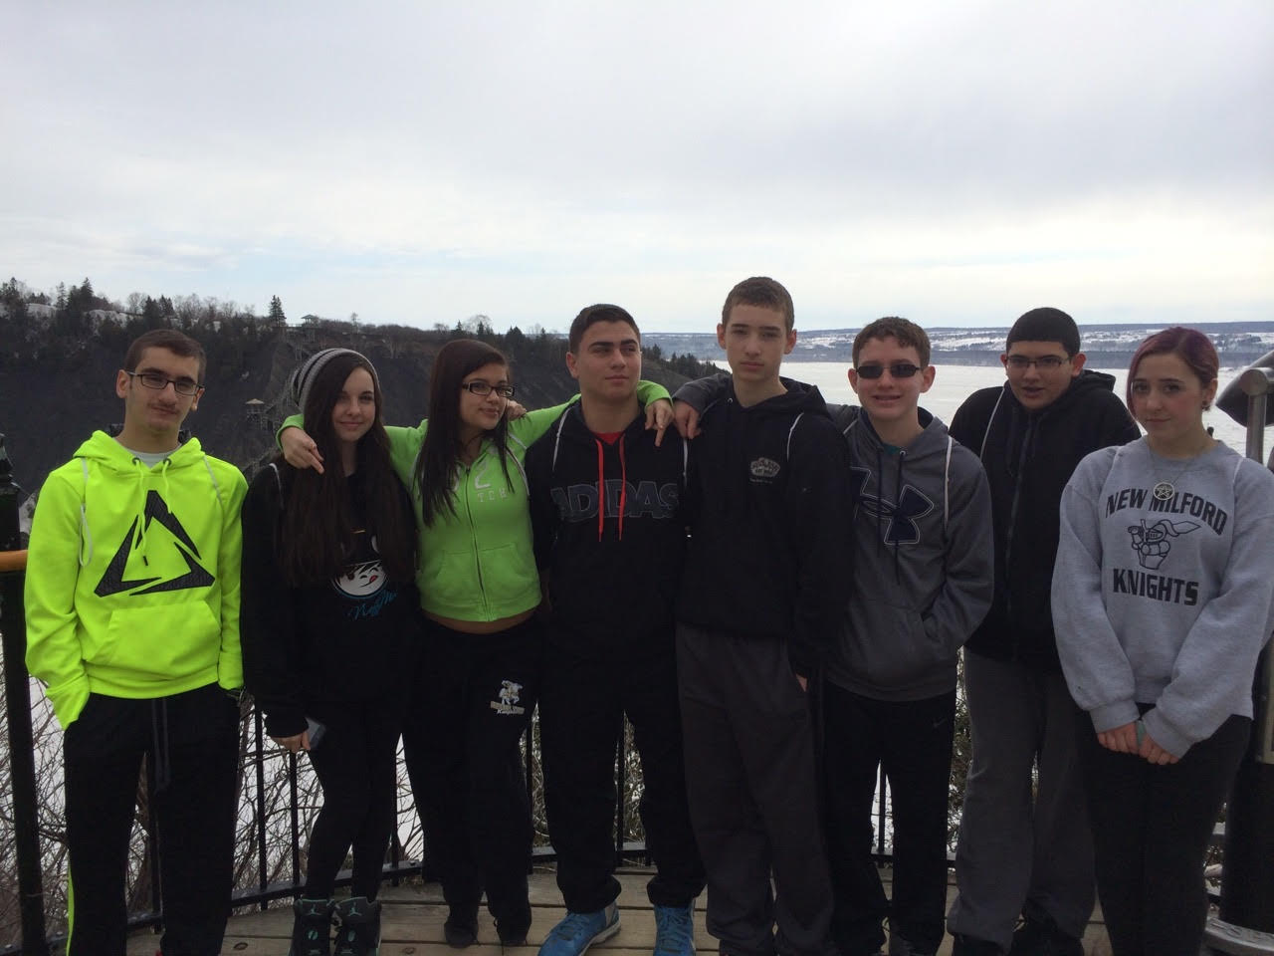
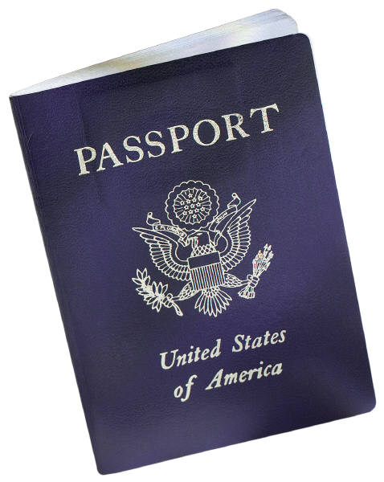
Rules &Procedures
Règles & Démarches
Drop off is at 4:30 AM
Boarding time is at 5:30 AM
Bags should be dropped off in the cafeteria – Chaperones will be waiting for students to arrive.
*For safety purposes, we will have to check through bags.*
Mr. Helwani/Mr. Nadeau will check males’ bags; Ms. Kolb/Mrs. Shanley will check females’ bags.
Students will be given the option to sit next to whomever they wish, however privilege may be revoked at any time due to disorderly conduct.
Permitted: Cell phones, books, notebooks, etc.
Not permitted: Laptops, iPads, iPods, Kindles, Nooks
We are not responsible for any losses of personal items.

Slide 4
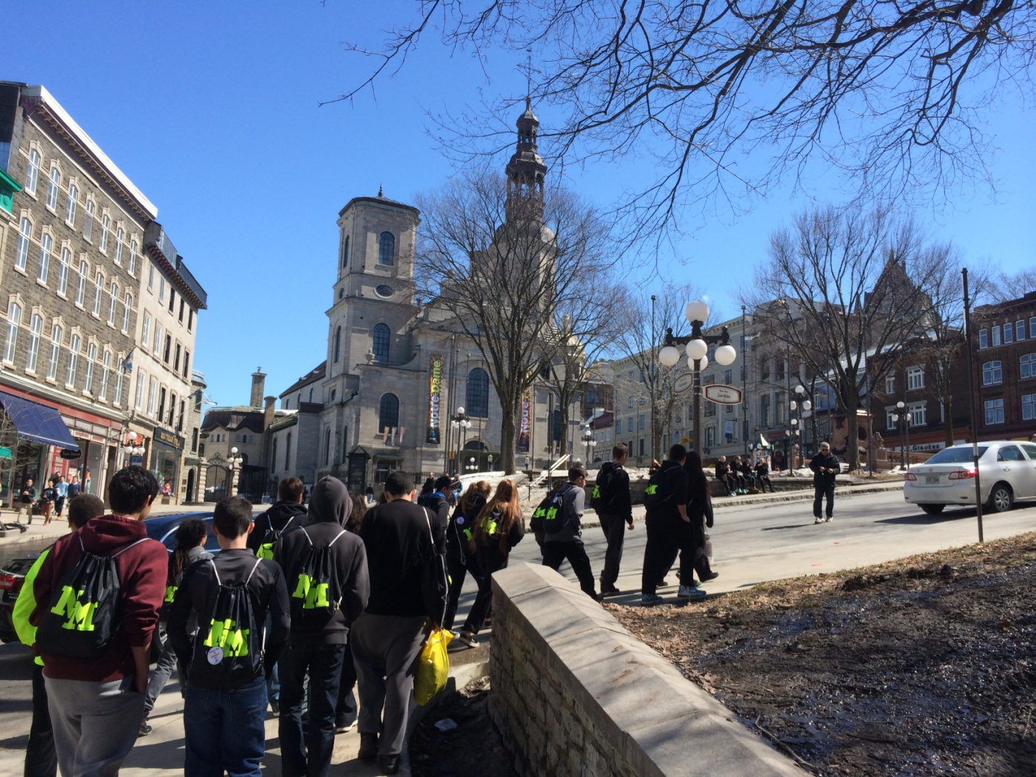
Arrival
Arrivée
Breakfast – We will stop on the way at a Tim Horton’s/other quick-style restaurant.
Upon arrival (roughly around 2:30 PM), we will meet the tour guide (TBA).
Hotel: Le Château Laurier (info. to be distributed)
Every child will be assigned a room number and escorted to their rooms.
Students will drop off bags and be escorted back to the Main Lobby.

Slide 5
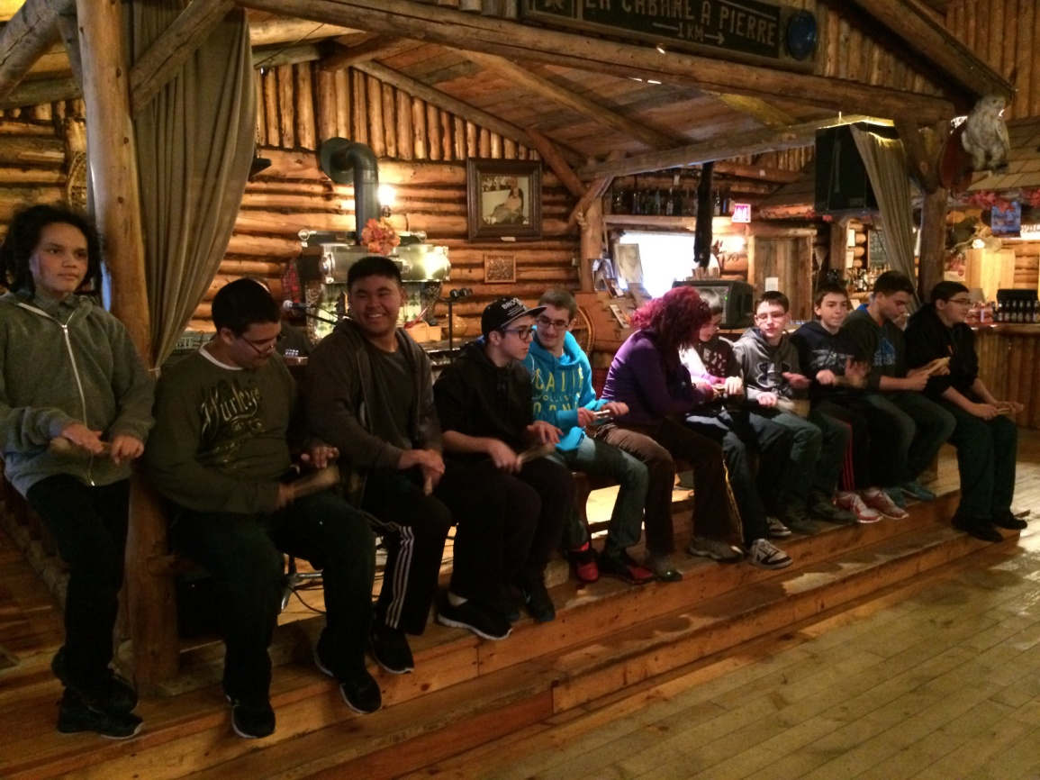
Ratio teachers/students
Rapport professeurs/élèves
Ratio is 1:10.
There are 40 participants attending (21 from DEOMS and 19 from NMHS).
There are 4 chaperones attending (2 from DEOMS – Mr. Helwani & Ms. Kolb, 1 from NMHS – Mr. Nadeau, 1 administrator – Mrs. Shanley).

Slide 6
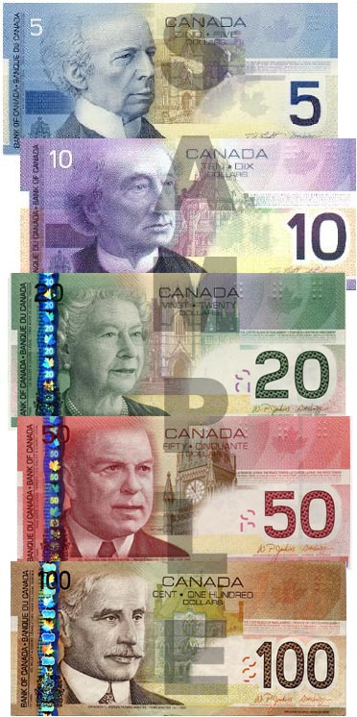
Cash
Espèces
Four envelopes should be put aside for each day’s allowance – Lunch on Thursday, Friday, Saturday, and Sunday.
Amount must be in CAD for the first three envelopes and in USD for the last envelope – (suggested) between 45-60$CAD and $20 USD. THIS IS FOR LUNCH ONLY – SOUVENIR MONEY SHOULD BE SEPARATE!
The money in those envelopes will be given to the Chaperones to then be given back to the students at lunchtime.
Envelopes must be handed to the Chaperones before students board the bus on Thursday, April 7. Each Chaperone will collect four (4) envelopes per student.

Slide 7

Medical Information
Informations médicales
Medical information will be made available on the DEOMS website through a PDF detailing the policy.
Please see attachment as a reference via the Reservation Forms.

Slide 8
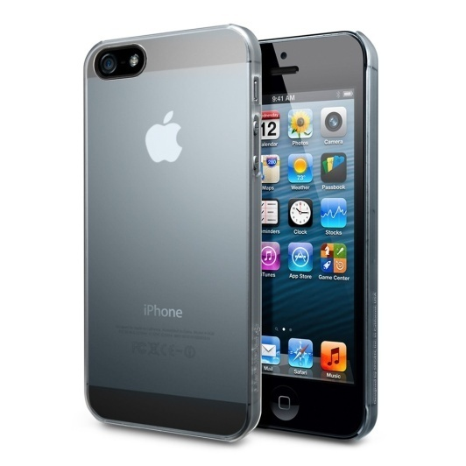
Cell Phones
Portables
Cell phones are permitted, however:
Chaperones will require numbers of all cell phones from participating students in advance.
Cell phones MUST NOT be used as a texting device during instructional time with the tour guide.
In the event of an emergency, please contact us:
Mr. Helwani – (973) 934-0157
Ms. Kolb – (551) 206-9883

Slide 9
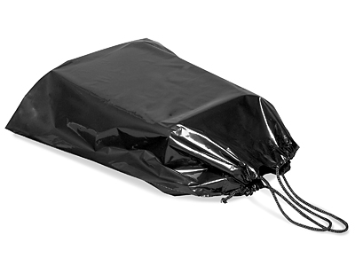
Group Item: Backpacks
Article du group : sacs à dos
We have the drawstring bags (HUGE thanks to Mrs. Heinemann). You will receive one this evening with a luggage tag inside from Immersion Tours (one per child).
Black drawstring backpack with NM letters printed on it.
Made available to the child at no additional charge.

Slide 10


Safety
Sécurité
Night guard will be on duty in Le Château Laurier from 10:30 PM through 4:30 AM.
Students will NOT be permitted to visit other friends in different rooms for safety purposes.
We WILL hold room checks while at the hotel. When curfew is called, students will be TAPED into their rooms.
Keycards will be given to students upon being escorted to their rooms.

Slide 11

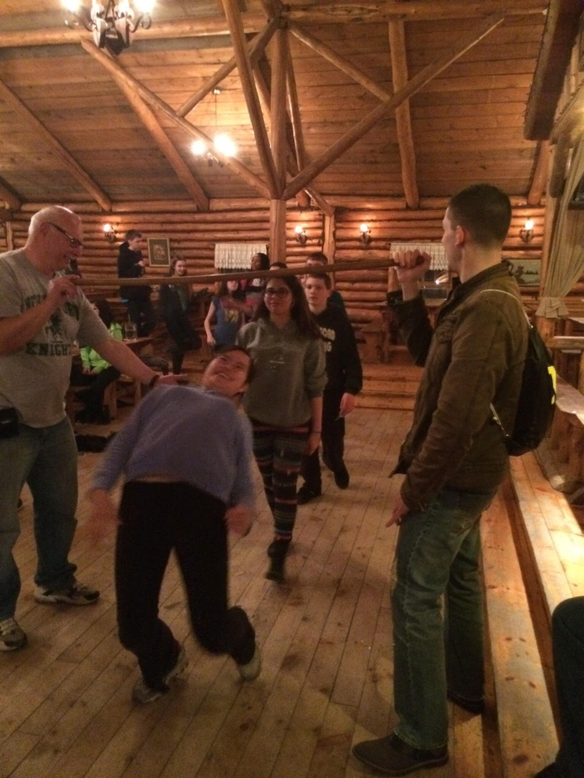
Questions ?
Mr. Issam Helwani
ihelwani@newmilfordschools.org
Mr. Serge Nadeau
snadeau@newmilfordschools.org
Ms. Heidi Kolb
hkolb@newmilfordschools.org
Mrs. Danielle Shanley
dshanley@newmilfordschools.org

